Slide 1
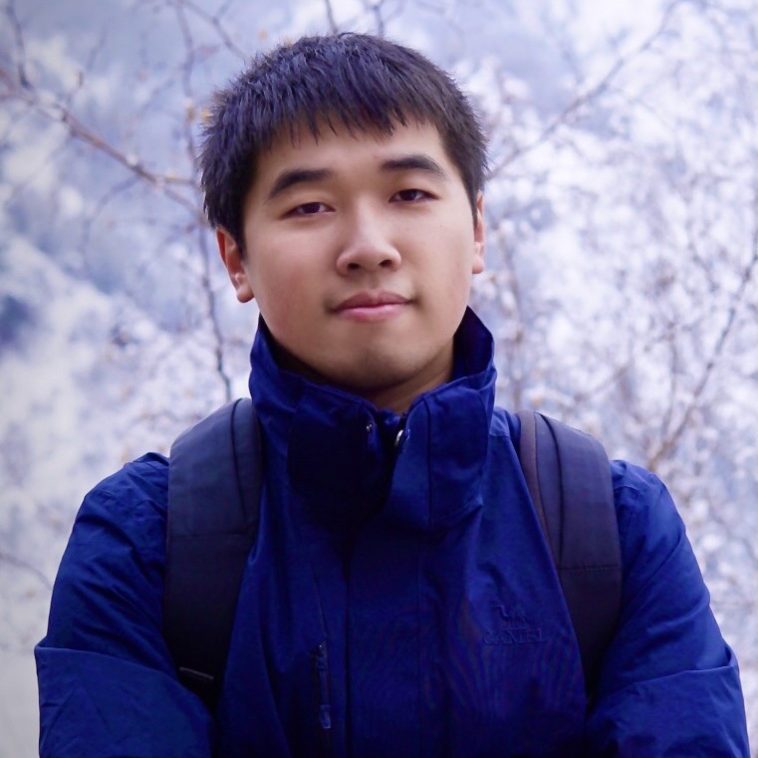
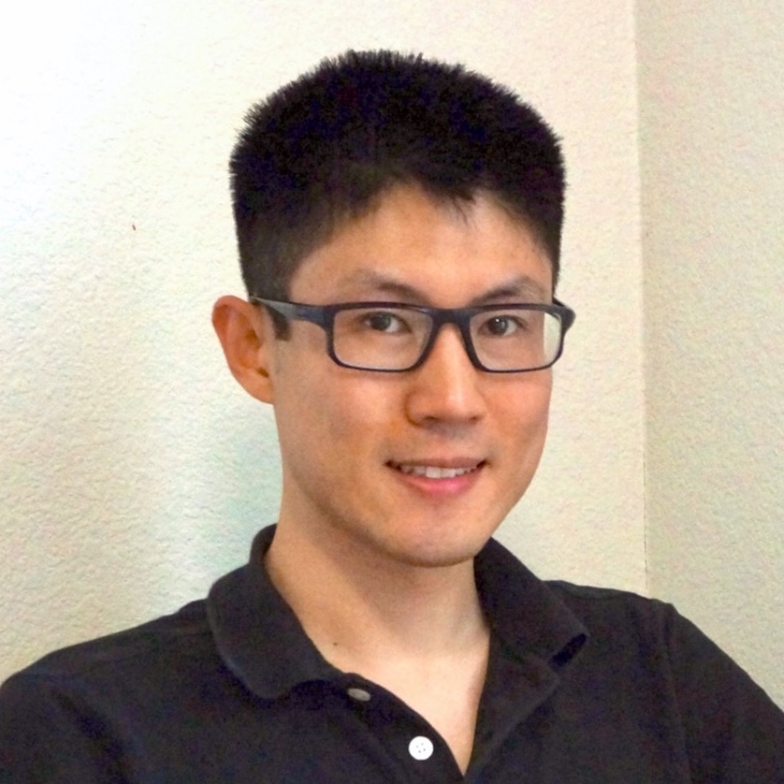
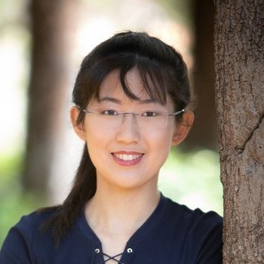
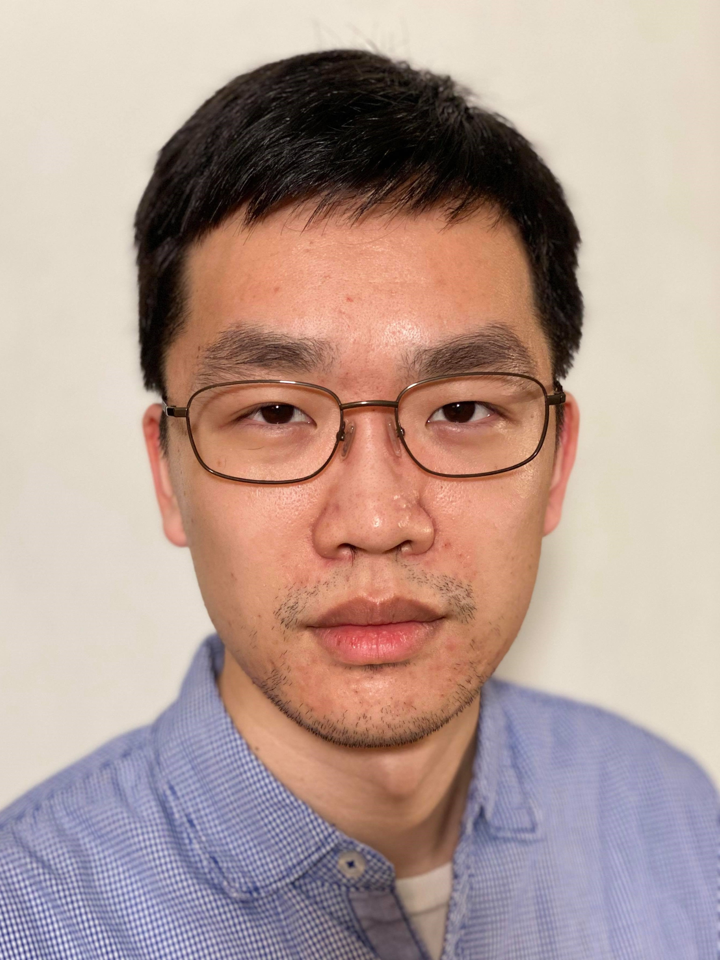
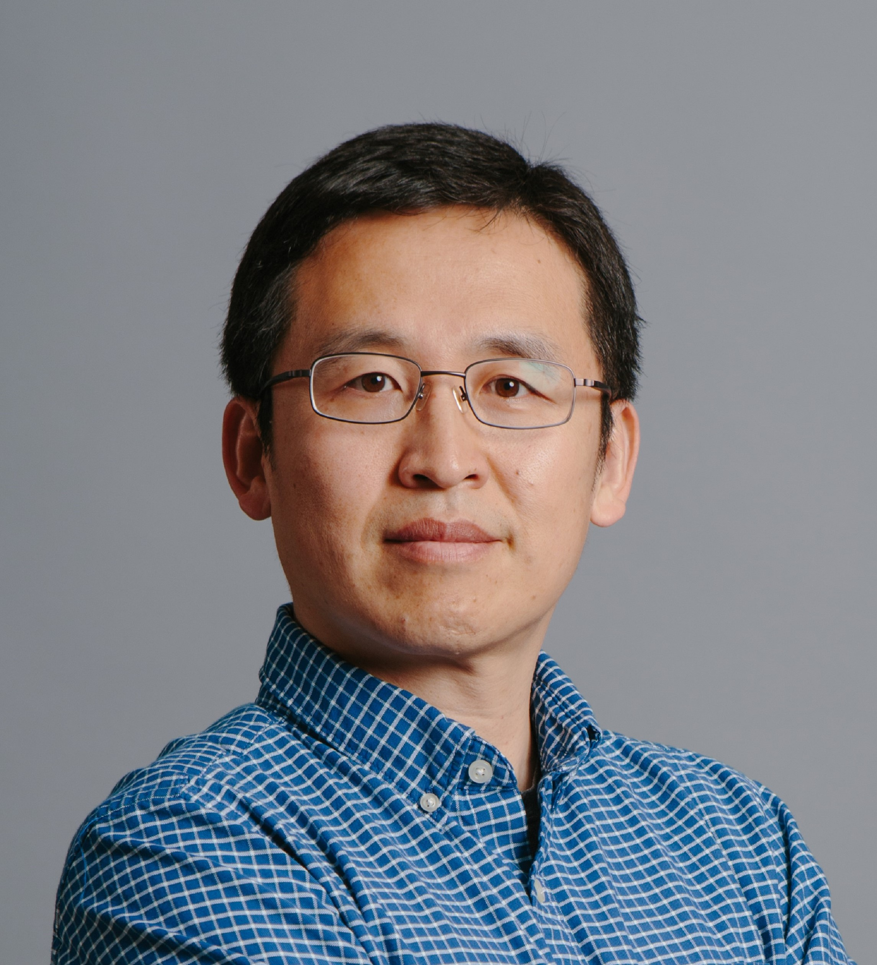
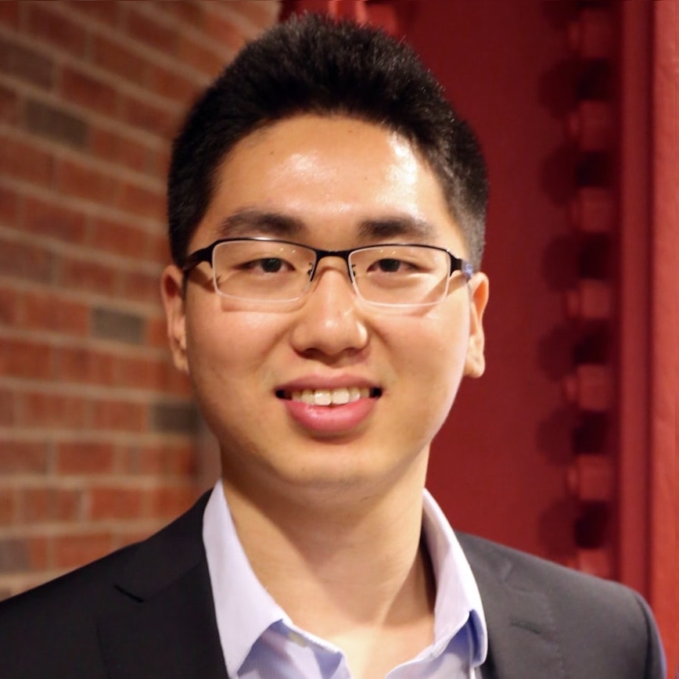
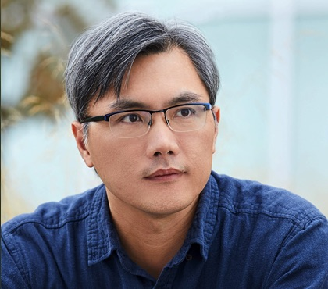



On Continual Model Refinement in Out-of-Distribution Data Streams
Bill Yuchen Lin^{1(intern), 2} Sida Wang¹ Victoria Lin¹
²
Robin Jia² Lin Xiao¹ Xiang Ren² Scott Yih¹
¹
ACL 2022
Notes:
Hi everyone, I’m Bill Yuchen Lin. I’m a final-year PhD student at USC advised by Xiang. And I was a summer intern working with Scott and these awesome peers at Facebook AI research in the last summer. In this talk, I will present our work on continual model refinement in out-of-distribution data streams.

Slide 2

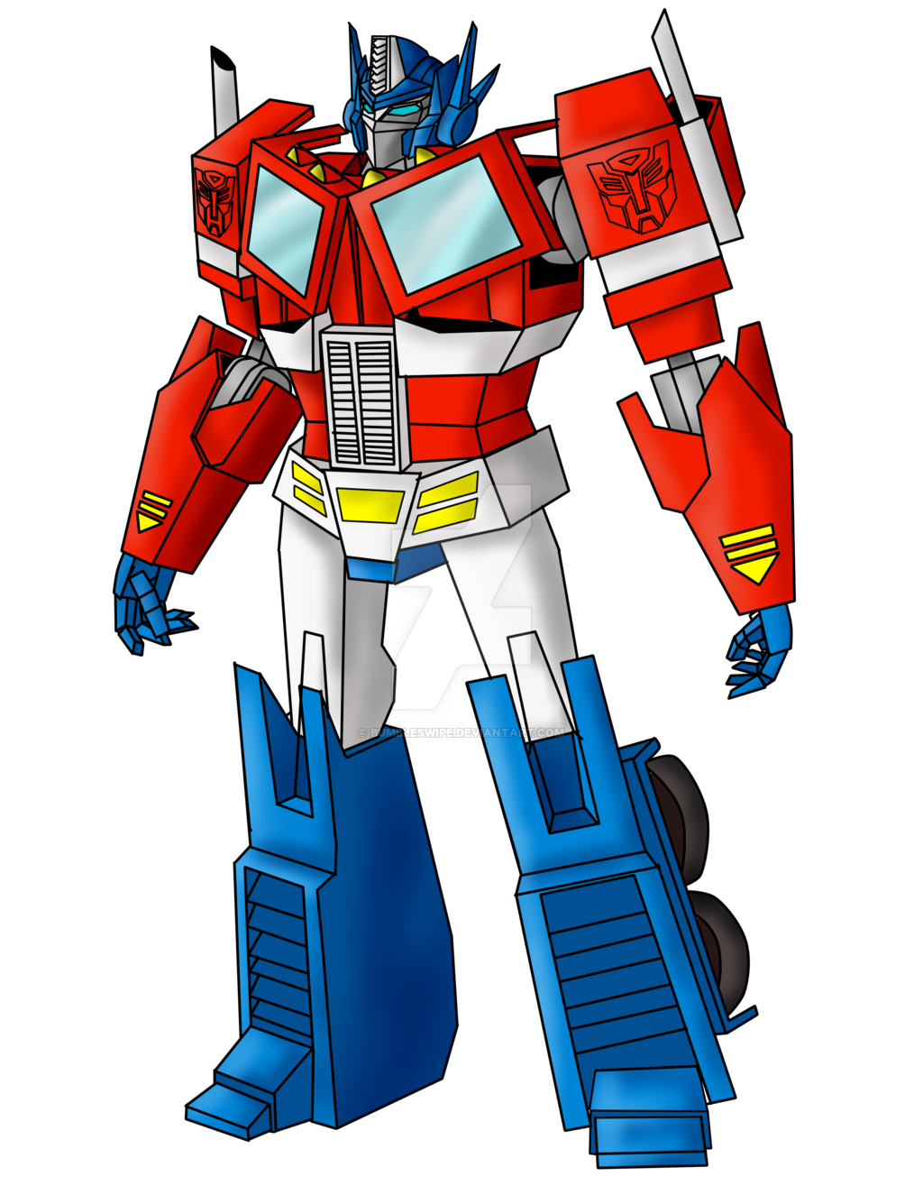
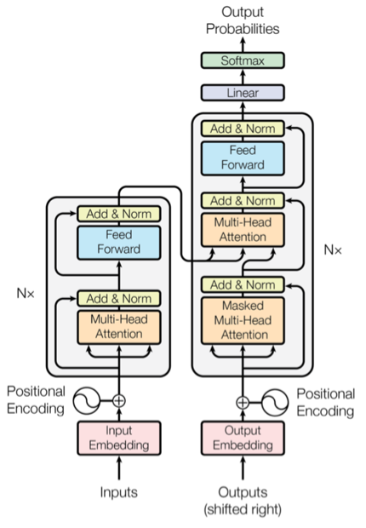
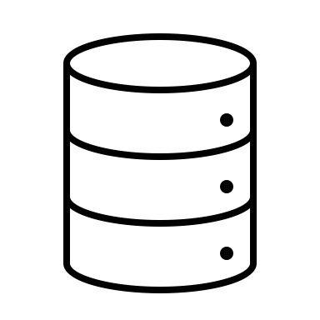
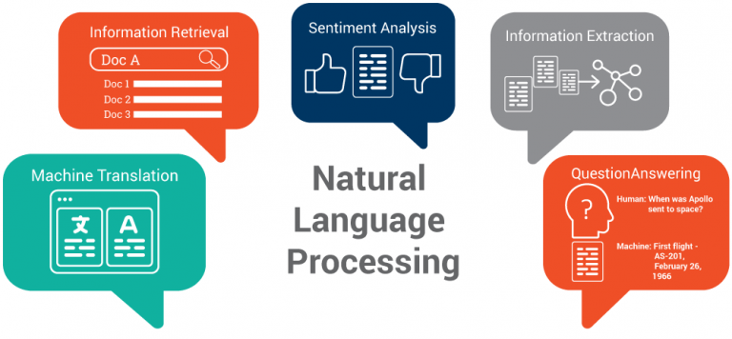
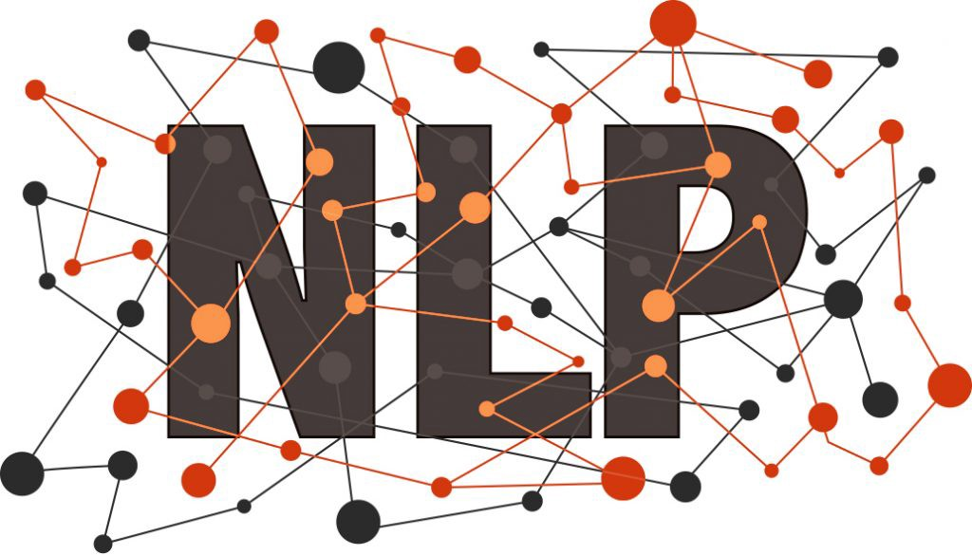



Deploying an NLP model
upstream
learning
deployment
NLP Service
Training Data
Real-world data
Neural Language Models
Notes:
Before we dive into our work, let’s rethink how we usually deploy an NLP model as a service.
First, we need to collect some training data of a particular task that our users are interested in, say question answering.
Then, we fine-tune a pre-trained neural language model such as BERT or BART to get a trained QA model.
Finally, we use the best model checkpoint as part of a bigger, more complicated system that supports the interaction between the NLP model and users.
This pipeline is so general that many NLP tasks can work very well with it, such as QA, summarization, information extraction and so on.
These NLP service will then accept a large amount of real-world data from online users.

Slide 3




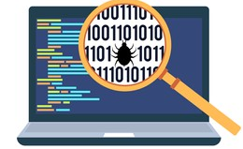





Fixing errors over time
NLP Service
≠
prediction errors!
fix the errors?
report
corrected
data
annotate
(human-in-the-loop)
Can we continually update a deployed model to fix errors without forgetting previously acquired knowledge over time?
Notes:
Such NLP service can be very powerful if user data are also drawn from the same distribution as the training data.
But in real-world scenarios, there must be some user data that are under-represented by the training distribution.
Therefore, the model can often make mistakes. Users may find these prediction errors very disappointing.
And they may report some of them to the providers of the service. If we are the providers and we want to fix these errors, then we often need to recruit some human annotators to annotate these error cases. And then we use the corrected data to refine the backend NLP model. This would be the general pipeline if we want to continually update an NLP model over time for fixing its incoming errors.
However, it’s likely that the updated model forgets the previously acquired knowledge, so our research question in this paper is: Can we continually update a deployed model to fix errors without forgetting previously acquired knowledge over time? This is an important and very practical problem setup, while it is not well studied in the online learning or continual learning literature.

Slide 4
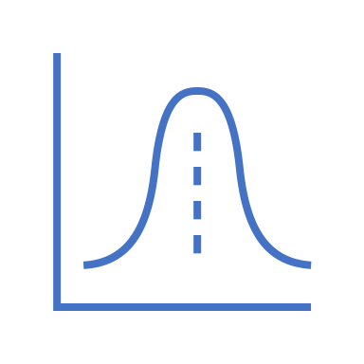
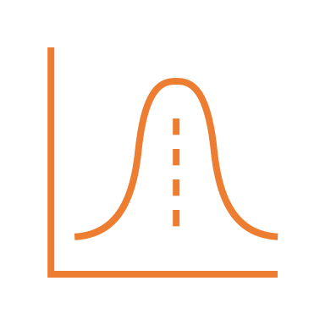
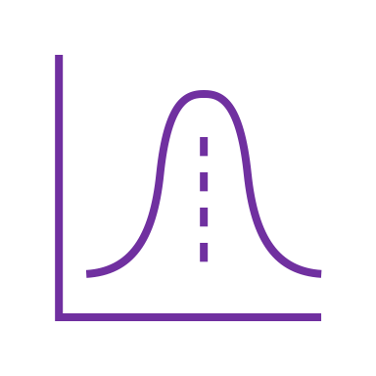












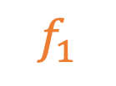
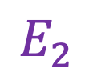
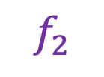
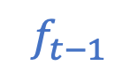
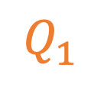

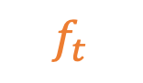
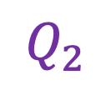
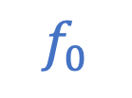


Continual Model Refinement (CMR)
🌈 everchanging distribution shift in online data
upstream
dist.
……
t=0
t=1
t=2
t=T
Time
$$D$$
upstream
data
$$Q_{1}$$
$$Q_{2}$$
……
…
offline
training
Query stream
online query data
online query data
report & annotate
…
Error stream
$$f_{0}$$
$$E_{1}$$
$$E_{2}$$
……
$$E_{t}$$
Upstream Learning
……
$$f_{1}$$
$$f_{2}$$
$$f_{t−1}$$
A CMR method
$$f_{t}$$
Notes:
So, in this paper, we propose a novel continual learning formulation named continual model refinement (CMR).
First off, we assume that the initial model f_0 is offline trained with a large dataset which we called the upstream data.
The goal of this upstream learning stage is to get a decent initial model by fine-tuning neural LMs.
Then starting from this time point 0, the model serves some online query data from the users. We use Q_t here to denote the user query data at t-th time point, and the annotated errors in Q_t is E_t here. So a CMR method needs to use both the previous model f_{t-1} and the current error data E_t to refine the model, so that the updated model f_t becomes a stronger, more robust model for serving users. Note that this is a continuous process, so we do not want a CMR method to be computationally expensive. Also, a key challenge here is that we assume the underlying data distribution is changing over time, so it is a dynamic out-of-distribution data stream.

Slide 5
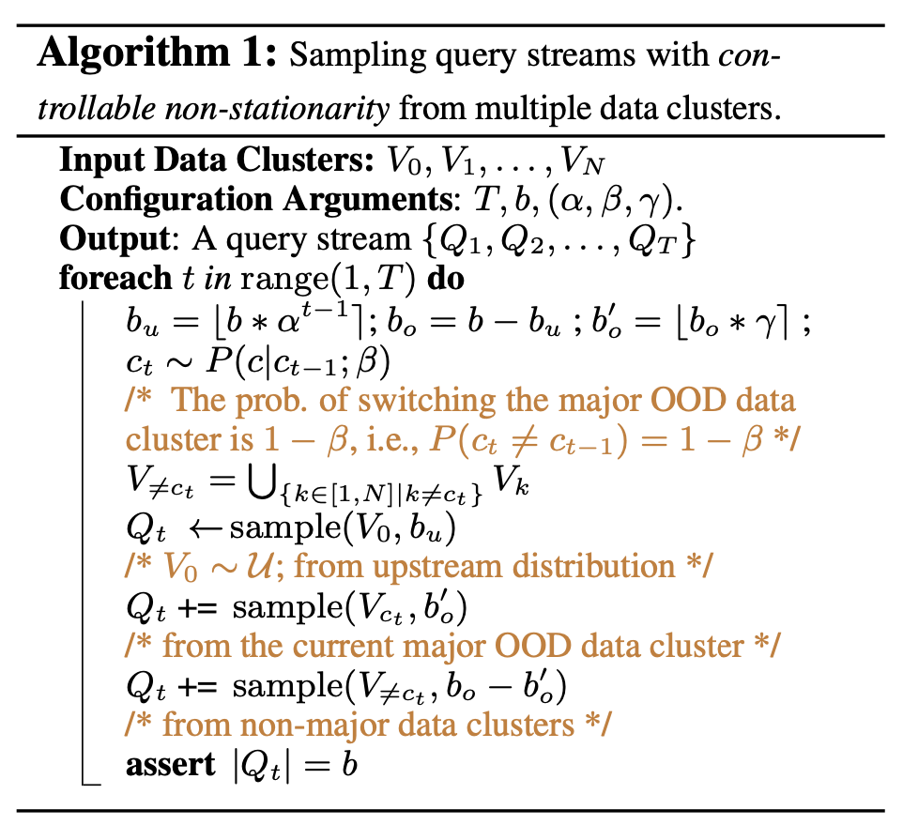
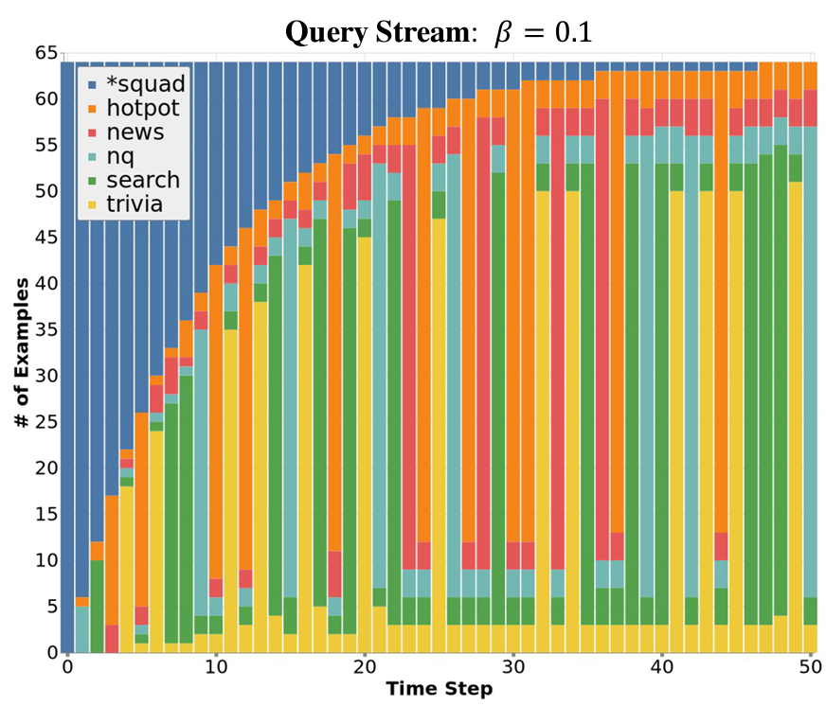


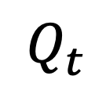
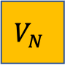

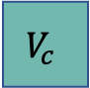
Evaluating CMR: OOD Data Stream
✅ boundary-agnostic
✅ ctrl. non-stationarity
✅ diverse OOD mixture
$$V_{0}$$
1️⃣
$$V_{1}$$
3️⃣
…
$$V_{c}$$
1️⃣
…
2️⃣
2️⃣
$$Q_{t}$$
$$V_{N}$$
3️⃣
3️⃣
t
Notes:
A natural question here is then, how should we create such OOD data streams?
In this paper, we propose a novel algorithm for sampling query streams to simulate the real-world scenarios for CMR.
Here is a partial example for visualizing the distribution of the query streams. We only show the first 25 time steps here.
For each time step, the query data is a mixture of multiple data sets of the same task while they have distinct distributions.
One of them has the same distribution as the upstream data that we used for offline training the initial model. It is denoted as V_0. Here in this case, the V_0 is from the SQUAD, and then other N datasets such as HotpotQA and nq are then OOD data clusters. We can see that in our sampling algorithm, each query set at a time point is composed by three parts:
1) the first part is from V_0 which means the data set that is drawn from the upstream distribution, and the proportion of this part gradually decrease over time.
2) the second part is from V_c . The index c here can be any number from 1 to N, which is sampled by a Markov chain over time. It is used as the major OOD cluster at a particular time point. For example, the major OOD cluster of the 25th time point is natural questions.
3) finally, the third part is randomly selected from the other OOD data clusters so that the diversity inside each timestep is ensured.
We leave more details of this algorithm in our paper and we'd like argue that the unique features of our sampled streams are that:
it is boundary-agnostic, has controllable non-stationarity, and diverse OOD mixtures. All these features together make it much closer to the real-world application scenarios.

Slide 6

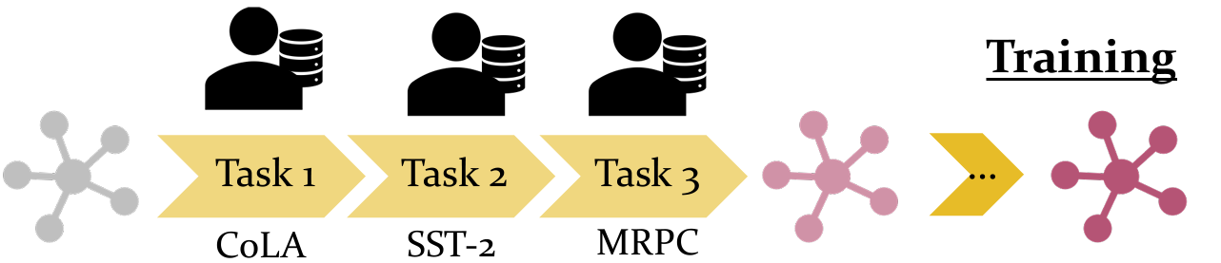


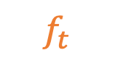
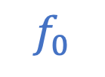
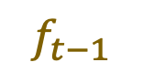
CMR as a novel CL formulation
a multi-task model
The typical CL setup
boundary-aware
pre-defined data streams
disallowing revisiting the past dist.
single dist. to learn in a period
CMR: a more realistic CL setup
boundary-agnostic
dynamic streams of pred. errors
allowing revisiting the past dist.
diverse mixtures of OOD data
errors
error
fixing
OOD data
…
…
an adaptable service
for real-world applications
upstream
data
$$f_{0}$$
$$f_{t−1}$$
$$f_{t}$$
Notes:
Some people may ask: what’s the difference between CMR and other CL formulations? Here we compare the CMR and the typical CL setup side by side.
The typical CL problem seeks for a multi-task model in the end; And they usually use a boundary-aware data stream for online learning, where the transition between tasks is sudden. The data in the stream for learning is predefined, and it won‘t allow the model to revisit past distributions. Also, the model has to focus on a single underlying distribution to learn in a period of time.
We argue that all these assumptions are hardly realistic in real-life applications.
In contrast, the CMR is boundary-agnostic with controllable non-stationarity, the online data to learn are dynamically generated by monitoring the prediction errors. Our algorithm also supports revisiting and enhance the diversity a lot.
The final goal of CMR is to produce a more adaptable NLP service for real-world applications.

Slide 7
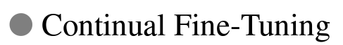
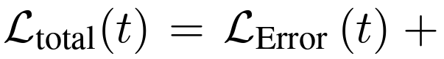
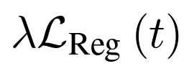
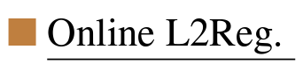

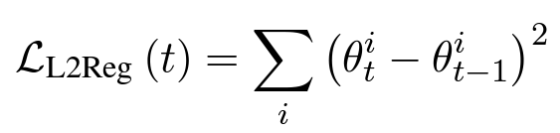
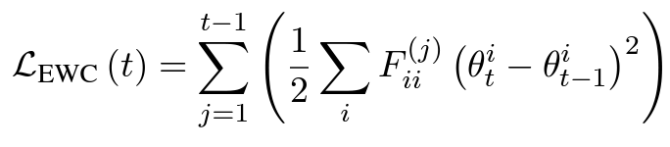




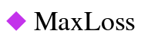
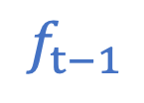


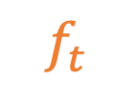
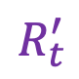
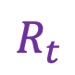
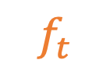
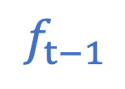
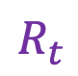
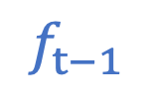

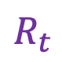
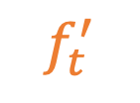
CMR Methods: Regularization| Replay
$$E_{t}$$
$$f_{t−1}$$
$$f_{t}$$
Memory
Conditional Replay
$$E_{t}$$
random
retrieval
$$E_{t}$$
$$R_{t}$$
$$f_{t−1}$$
$$f_{t}^{′}$$
random
retrieval
$$R_{t}^{′}$$
$$R_{t}$$
$$R_{t}$$
$$f_{t−1}$$
$$f_{t}$$
Notes:
Now let’s look at some CMR methods that we adopted form the general continual learning literature.
First off, we can just simply fine-tune the previous model with the new annotated error data via a normal optimizer like Adam. We refer this simple method to continual fine-tuning.
Simply tuning the model to fit the error data can make it forget the previously acquired knowledge. Therefore, a typical category of CL methods try to add regularization terms to the total loss to avoid forgetting. We here present two typical methods: L2-regularization and EWC, which uses the fisher information to give different weights on different parameters when computing penalty.
Instead of adding a regularization term, we can also maintain a memory module that stores the past data and replay a small part of them when learning to update the models over time. That is to say, we combine both the error data E_t and the replayed data R_t for fine-tuning f_{t-1} to f_t.
A simple method is to perform random replay from the memory, it’s a classic CL method and it’s also named experience replay.
This random process is not aware of what we want to learn at the current time point.
A more desirable method is to replay the most forgettable examples in the memory conditioned on the given error data to learn.
To reduce the computation cost, we first randomly oversample a large buffer from the memory and then compute the loss on both the previous model and a virtual model. The virtual model here is actually the one if we used E_t only for fine-tuning.
The difference between MIR and Max Loss is that MIR rank the buffer examples by the delta of the loss on these two models, based on the assumption that the larger loss delta means being more forgettable. MaxLoss method take the loss on the virtual model for ranking. They both use the top-K as the final retrieved data for replay-based learning.

Slide 8























Evaluating CMR: Metrics
$$Q_{<t}$$
$$D$$
Error Fixing Rate (EFR)
Cumulative Success Rates (CSR)
…
upstream data
$$E_{t}$$
$$Q_{1}$$
$$Q_{2}$$
$$Q_{t}$$
$$H$$
…
$${=Q}_{<t}$$
held-out data
$$E_{t}$$
$${=E}_{<t}$$
$$f_{t−1}$$
A CMR method
$$f_{t}$$
Upstream Knowledge Retention (UKR)
Knowledge
Generalization (KG)
test
How should we evaluate CMR methods?
Fix errors: EFR
Memorizing acquired knowledge: U/O-KR
Adaptability to online data: CSR
Generalization to unseen data: KG
Online Knowledge Retention (OKR)
test
t=T
test
Notes:
Apart from the data stream creation and the CMR methods, it is also very important to propose new evaluation metrics for CMR so that we can monitor the performance of the CMR methods in real-time and get a comprehensive understanding.
Here on the left-hand-side, it is figure for us to review what a CMR method needs to do at time t.
And the first metric we want to introduce is the error-fixing rate. It’s very straightforward, we just look at what percentage of the reported errors in E_t will be fixed by f_t which is updated by a certain CMR method. We hope all CMR methods can get a high error-fixing rate so that the backend model can instantly fix the errors and make users happier.
That being said, it’s also very important to monitor the knowledge retention of the model, so we propose two metrics for monitoring the forgetting issue of the upstream knowledge and the online acquired knowledge respectively, namely UKR and OKR.
Additionally, we can assess the adaptability of a CMR method by looking at its cumulative success rate, which is the percentage of correctly predicted examples among all query data until the current time step. It can well represent the extent of user satisfaction.
We want to know the performance of the updated model for a longer term but we cannot test them forever. Given a limited number of time steps, we test the generalization ability on some held-out data. And this is the KG.

Slide 9





Fixing errors & Overcoming catastrophic forgetting
T=100
Error Fixing Rate (EFR)
$$E_{t}$$
all can fix the errors pretty well
(on average)
forget upstream knowledge
forget
online knowledge
Notes:
So, let’s first look at the how these CMR methods perform in terms of the error fixing rate. We can see that on average all these CMR methods can achieve a very high EFR larger than 97%. Meaning that they can all fit the error data very effectively.
But how well can they keep the previously acquired knowledge? For the upstream knowledge, the UKR metric at time T, tells us that if we only use the simple continual fine-tuning method, the performance on the upstream distribution decreases a lot. from 80 to 66. And both reg. -based and replay-based methods can improve this a lot.
Generally, the replay-based methods can memorize the upstream knowledge better than reg. methods.
As for the online knowledge that comes form the annotated errors, we find that still replay-based method MIR outperforms others. Interestingly, we find that EWC is better on memorizing the online knowledge while L2Reg is better at the upstream knowledge.
The first row, frozen upstream, is the reference method that always takes the initial model for all time steps, while the last row, offline refining is the reference method that we retrain the initial model with all errors at the same time.
Overall, we find that there are still a large space for these CMR methods to improve.

Slide 10




Adaptability & Generalization to OOD Knowledge
KG: Knowledge
Generalization
CSR: Cumulative Success Rates
t=T
test
…
$${=Q}_{<t}$$
$${=E}_{<t}$$
Notes:
We also evaluate the CMR methods in terms of their adaptability and generalization ability.
We find that as time goes by, the MaxLoss method becomes the one that has the least errors at the end. Meaning that the MaxLoss method might be the best one to adapt the model to the emerging distribution in the data stream.
As for the generalization ability, we find that the two typical CL methods, OnlineEWC and random replay have the best potential to succeed in the end on unseen future data.

Slide 11

Orthogonal improvement from CMR methods
1
2
3
4
What if we combine Regularization & Replay methods for CMR?!
Notes:
According to these empirical results, we find that there’s no such a CMR method that can always outperform others. And this makes us curious about the question that if the improvement from these CMR methods are orthogonal?
To study this, we draw heatmaps for visualizing the pair-wise differences between the predictions of all CMR methods at two periods of time.
Comparing block 1 and 2, we can find that CFT and regularization methods are quite similar to each other while they are quite different from replay-based methods.
Also, look at 2 and 4, the replay methods themselves are also quite different from each other.
Comparing 1 and 3 (or similarly for 2 and 4), we can see that such divergences become stronger over time. So we wonder maybe it’s beneficial to combine the replay and reg. methods for CMR? Our preliminary analysis in the paper indeed show that it is very promising to develop a hybrid method for CMR.

Slide 12
Conclusion
CMR: a more realistic CL setup for updating deployed models
Goal:
fixing prediction errors in OOD data streams
overcoming forgetting issues during online learning
Evaluation protocol:
a sampling algorithm to generate realistic data streams
metrics: EFR, U/O-KR, CSR, KG
Analysis:
adaptation of CL methods
extensive analysis & non-trivial findings
https://cmr-nlp.github.io/
Notes:
In this paper, we propose a novel continual learning formulation named continual model refinement (CMR). The CMR problem aims to efficiently fix prediction errors when learning in out- of-distribution data streams without catastrophically forgetting the acquired knowledge.
For studying such a realistic and complex problem, we presented a dedicated evaluation protocol with a general method to create non-stationary, diverse OOD data streams for analysis. Also, we design multiple evaluation metrics to deliver a comprehensive yet concise measurement of CMR methods.
We have a very extensive evaluation and analysis section in our paper but due to the time limit, we are showing only the most important findings in this talk. Please refer to our paper for more interesting discussion.
We hope our work will spur further research on this important and practical research problem. Thank you very much!

